Slide 1



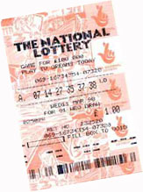
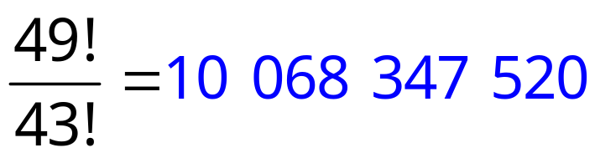
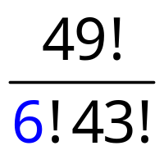


National Lottery: Jackpot Odds
6
26
35
15
28
49
It could be you!
But its highly unlikely.
6 balls
49 x 48 x 47 x 46 x 45 x 44
Permutations:
Combinations
^{n}P_{r}
A permutation is an ordered selection without repetition.
^{n}C_{r}
A combination is an un-ordered selection without repetition.

